Slide 1
Objects, Loops, & Review Lab
Front-End Web Development

Slide 2
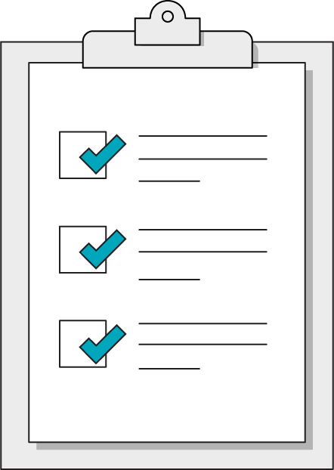
Today’s Learning Objectives
In this lesson, you will:
Apply CSS and JS skills to fit requirements of an assigned project.
‹#› | © 2020 General Assembly

Slide 3
Objects
Front-End Web Development

Slide 4
Objects
Objects are another type of data in JavaScript. Like arrays they hold multiple pieces of data. Unlike arrays, they use properties instead of keys AND the properties are in no particular order.
let myObject = { ‘fruits’ : [ ‘orange’ , ’apple’ ], ‘veggies’ : [ ‘celery’ , ’carrow’ ] }

Slide 5
Syntax
const produce = {‘fruits’:["banana", "orange", "apple"]}
You make an array using a set of curly brackets.
Inside the brackets, each value must have a property name and value delimited by a colon and separated by a comma.
Object can contain, strings, numbers, booleans, functions, other objects or any of these combined.

Slide 6
Petfinder
Front-End Web Development

Slide 7
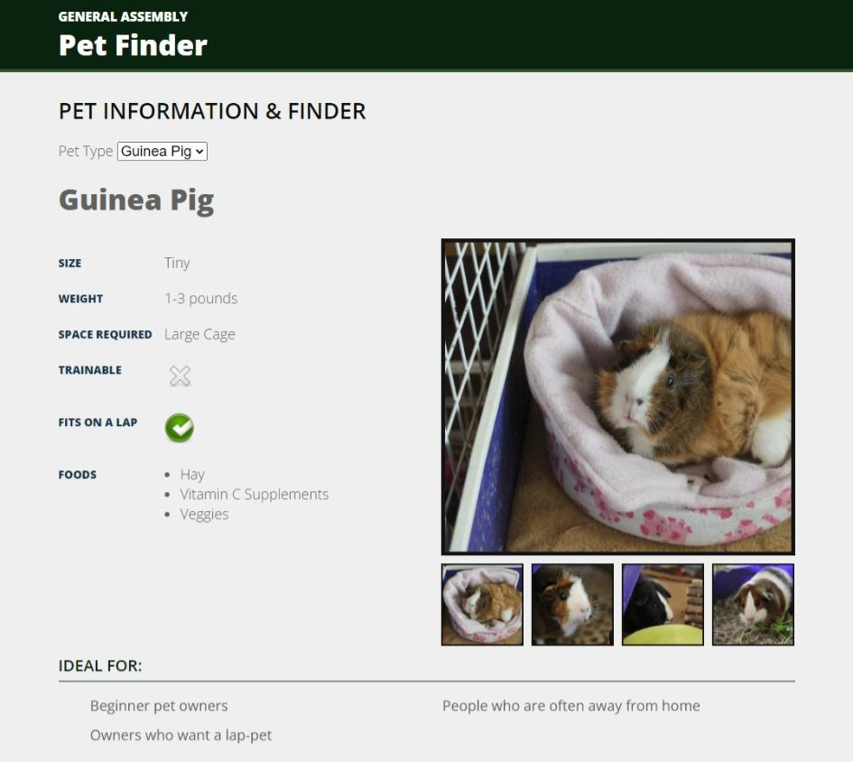
Pet Finder
120 minutes
Today, you’re going to build a page to help users learn about potential pets. To build this page:
Figure out what type of pet has been selected
Loop through all the types of information for that pet type
Output it on the DOM
Note: some types of information may need be transformed from what is in the object.

Slide 8
Pet Finder
Loop through each selected part of the object to create the pet information!
Starter code:
https://drive.google.com/drive/folders/1ECuJBSbGJDlRk5cn1RxwcSR1n4kZSm7-?usp=sharing
Solution code:
https://drive.google.com/drive/folders/1zvil6ku62JpevHjVCCfiThFmWpTvFqv5?usp=sharing

Slide 9
Pet Finder: Encrichment - Ajax
In the previous exercise, we loaded the data from a statically defined object. Instead let’s load it on the fly using ajax!
Solution code:
https://drive.google.com/drive/folders/1Si9WDfKV_iaQ16ga87o0Bx7Lf3Zmo8P2?usp=sharing

